Slide 1
Sentiment Analysis for British Airways (BA) Customers Feedback on Skytrax
Presented by Faseni Fakoya
fasenifakoya@gmail.com

Slide 2
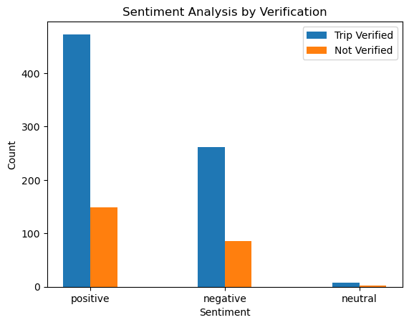
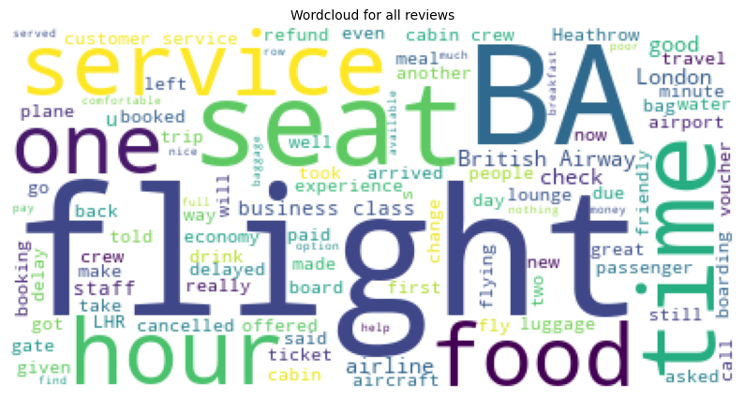
REVIEW VERIFICATION | SENTIMENT | Count
Trip Verified | Positive | 473
 | Negative | 261
Not Verified | Positive | 149
 | Negative | 86
Trip Verified | Neutral | 8
Not Verified | Neutral | 2
Total Comments Analysed 979

